Slide 1
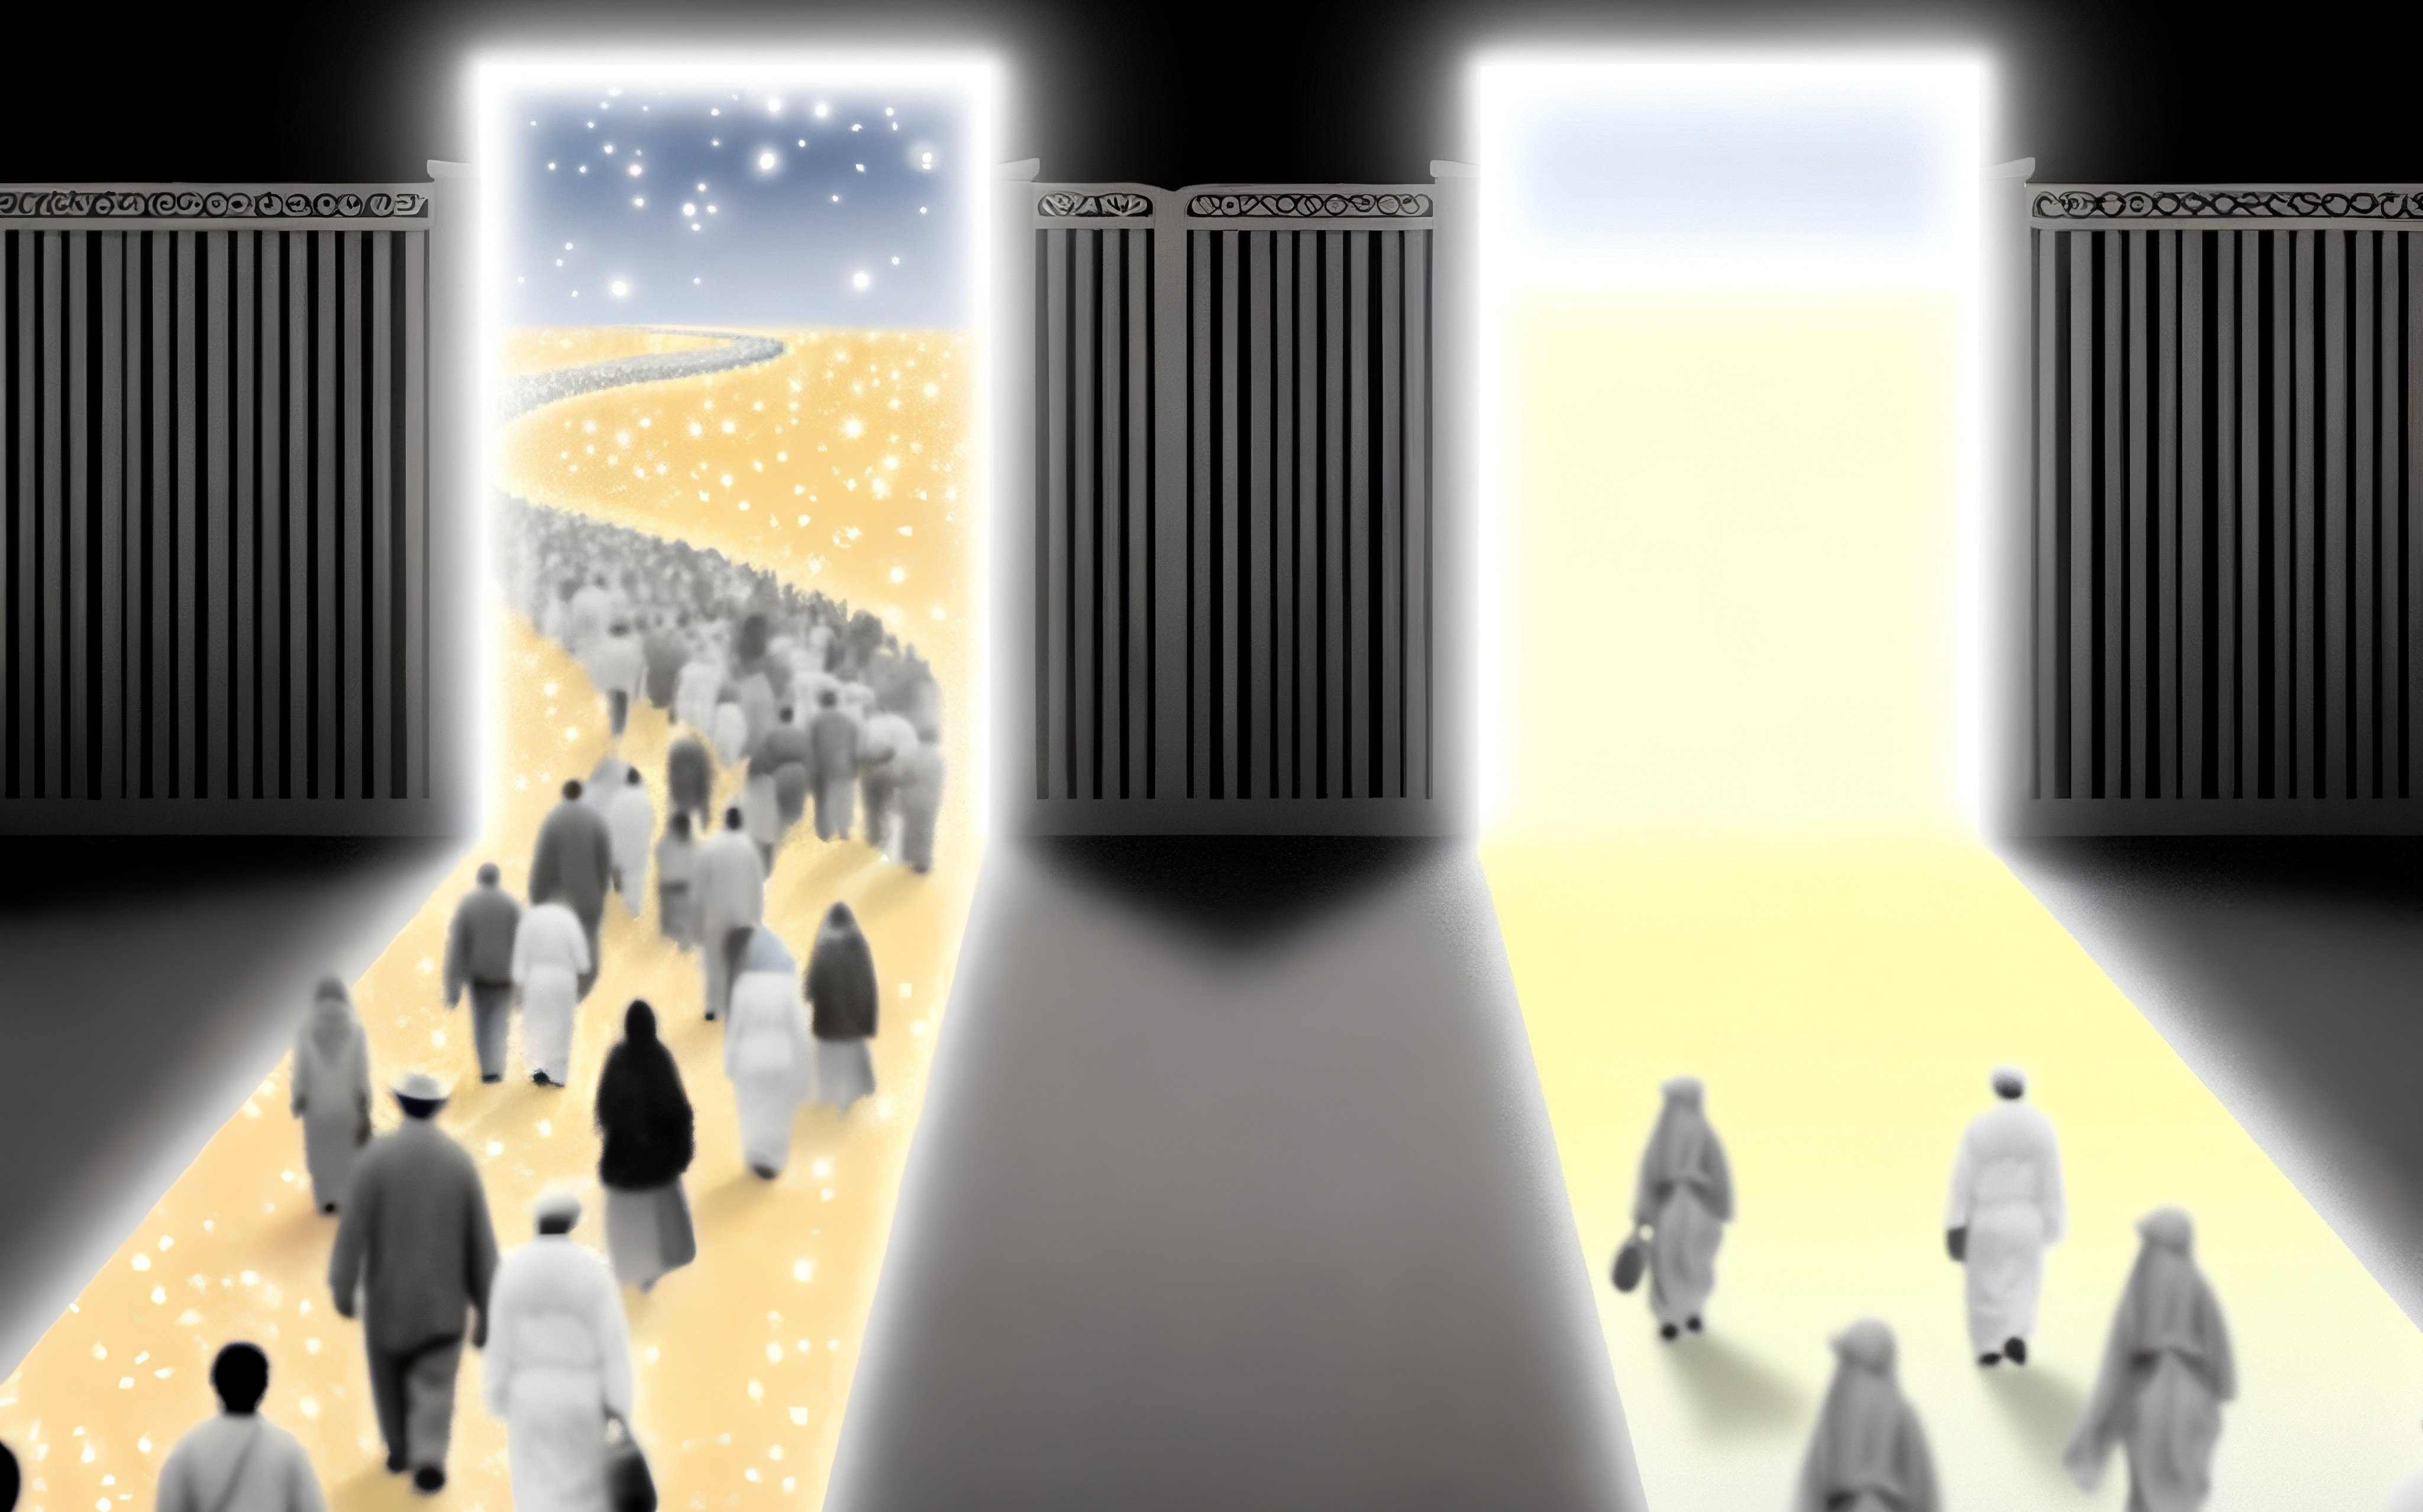
Just How Narrow is That Way?
Matthew 7:13-14
Notes:
Stuart Fain ~ February 14, 2016
~ July 14, 2019 (PM)
~ October 18, 2026 AM/PM

Slide 2
Matthew 7:13–14 (KJV)
¹³ Enter ye in at the strait gate: for wide is the gate, and broad is the way, that leadeth to destruction, and many there be which go in thereat:
¹⁴ Because strait is the gate, and narrow is the way, which leadeth unto life, and few there be that find it.

Slide 3
The Way Is So Narrow
That We Are Either Blessed or Cursed

Slide 4
Deuteronomy 30:19
I call heaven and earth to witness against you today, that I have set before you life and death, blessing and curse. Therefore choose life, that you and your offspring may live,

Slide 5
Luke 13:23-24
²³ And someone said to him, "Lord, will those who are saved be few?" And he said to them,
²⁴ "Strive to enter through the narrow door. For many, I tell you, will seek to enter and will not be able.

Slide 6
The Way Is So Narrow That
There Is Only One Path to Blessing

Slide 7
Ephesians 4:1–5
¹ I therefore, a prisoner for the Lord, urge you to walk in a manner worthy of the calling to which you have been called, ² with all humility and gentleness, with patience, bearing with one another in love,

Slide 8
Ephesians 4:1–5
³ eager to maintain the unity of the Spirit in the bond of peace. ⁴ There is one body and one Spirit—just as you were called to the one hope that belongs to your call— ⁵ one Lord, one faith, one baptism,

Slide 9
Ephesians 1:22–23
²¹ far above all rule and authority and power and dominion, and above every name that is named, not only in this age but also in the one to come.

Slide 10
Ephesians 1:22–23
²² And he put all things under his feet and gave him as head over all things to the church, ²³ which is his body, the fullness of him who fills all in all.

Slide 11
I Corinthians 12:12–13
¹² For just as the body is one and has many members, and all the members of the body, though many, are one body, so it is with Christ. ¹³ For in one Spirit we were all baptized into one body—Jews or Greeks, slaves or free—and all were made to drink of one Spirit.

Slide 12
The Way Is So Narrow That
God Built It Around Oneness

Slide 13
Proverbs 3:5–6
⁵ Trust in the Lord with all your heart, and do not lean on your own understanding.
⁶ In all your ways acknowledge him, and he will make straight your paths.

Slide 14
Romans 6:3–4
³ Do you not know that all of us who have been baptized into Christ Jesus were baptized into his death? ⁴ We were buried therefore with him by baptism into death, in order that, just as Christ was raised from the dead by the glory of the Father, we too might walk in newness of life.

Slide 15
I Peter 3:20–21
²⁰ because they formerly did not obey, when God's patience waited in the days of Noah, while the ark was being prepared, in which a few, that is, eight persons, were brought safely through water.

Slide 16
The Way Is So Narrow That
Only the Few That Work Walk It

Slide 17
Ephesians 5:15–17
¹⁵ Look carefully then how you walk, not as unwise but as wise, ¹⁶ making the best use of the time, because the days are evil. ¹⁷ Therefore do not be foolish, but understand what the will of the Lord is.

Slide 18
Revelation 3:15–16
¹⁵ "‘I know your works: you are neither cold nor hot. Would that you were either cold or hot! ¹⁶ So, because you are lukewarm, and neither hot nor cold, I will spit you out of my mouth.

Slide 19
The gate is strait — but the way is narrow. The gate is the goal — but the way is the journey. The question is not “Is the gate narrow?” The question is “Am I walking the narrow way that leads to it?”
.

Slide 20
Proverbs 4:25-27
²⁵ Let your eyes look directly forward, and your gaze be straight before you.
²⁶ Ponder the path of your feet; then all your ways will be sure.
²⁷ Do not swerve to the right or to the left; turn your foot away from evil.

Slide 21
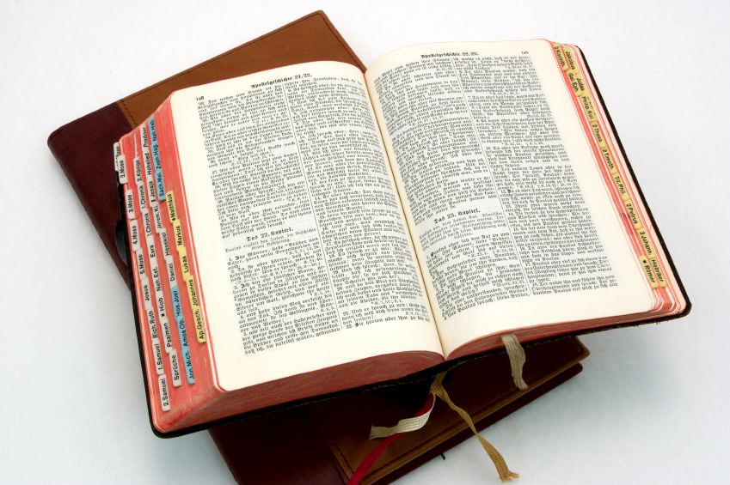
Hear: Romans 10:17
So then faith cometh by hearing, and hearing by the word of God.

Slide 22
Believe: Hebrews 11:6
But without faith it is impossible to please him: for he that cometh to God must believe that he is, and that he is a rewarder of them that diligently seek him.

Slide 23
Repent: Luke 13:3
I tell you, Nay: but, except ye repent, ye shall all likewise perish.

Slide 24
Confess: Matthew 10:32-33
32 Whosoever therefore shall confess me before men, him will I confess also before my Father which is in heaven.
33 But whosoever shall deny me before men, him will I also deny before my Father which is in heaven.

Slide 25
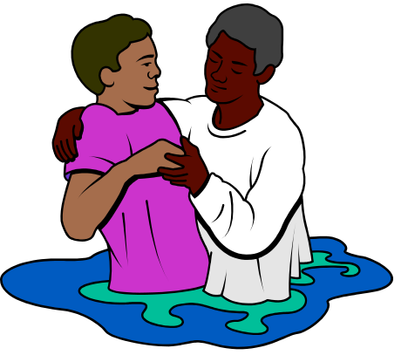
Baptize: Acts 22:16
And now why tarriest thou? arise, and be baptized, and wash away thy sins, calling on the name of the Lord.

